Slide 1
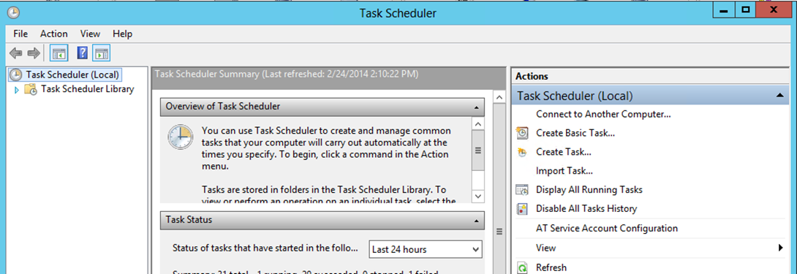
Open task scheduler (you can just search for it on windows) and then click “Create Task”

Slide 2
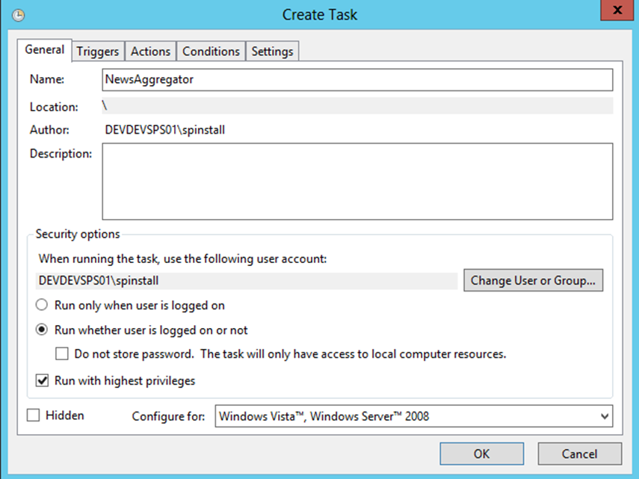
Set the name of the task and the account it runs under, then set it to run whether user is logged on or not and to run with the highest privileges then click ok.

Slide 3
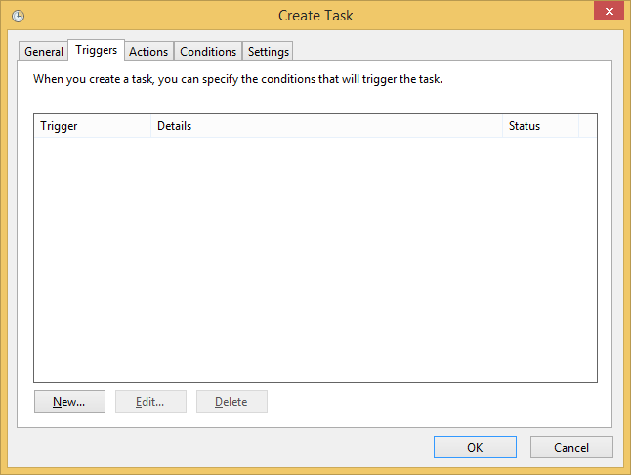
Click on the “Triggers” tab and then click “New” to add a new trigger for the task.

Slide 4
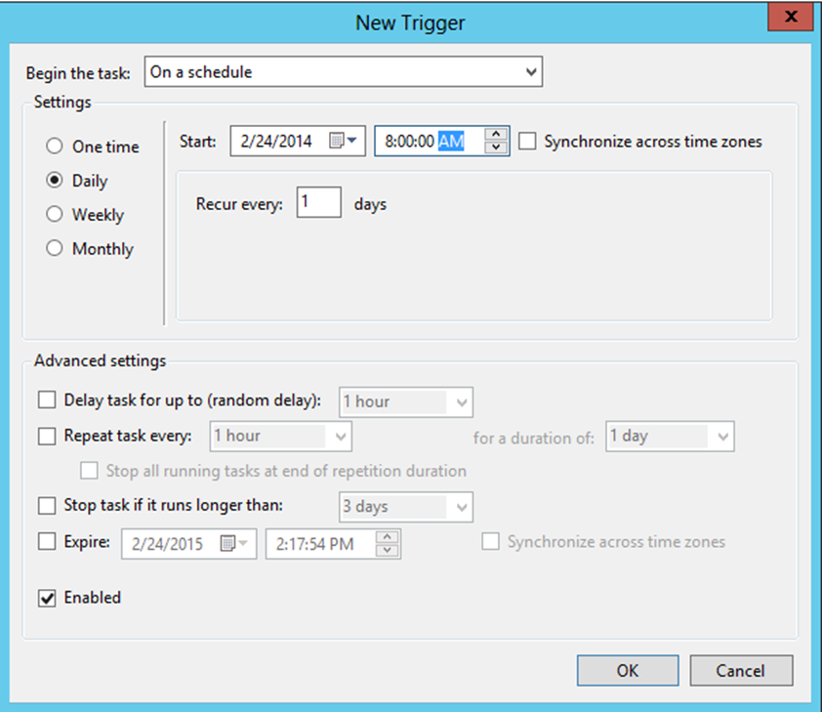
Set the task to run daily at a specified time and make sure it recurs every day and then enable the trigger.

Slide 5
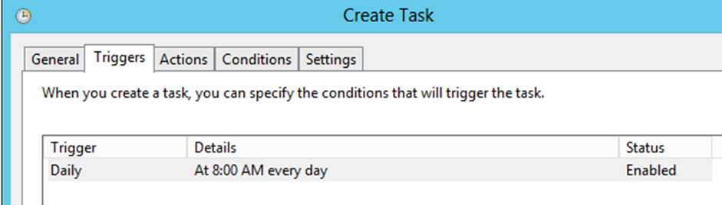
Make sure that the trigger is enabled for this task.

Slide 6
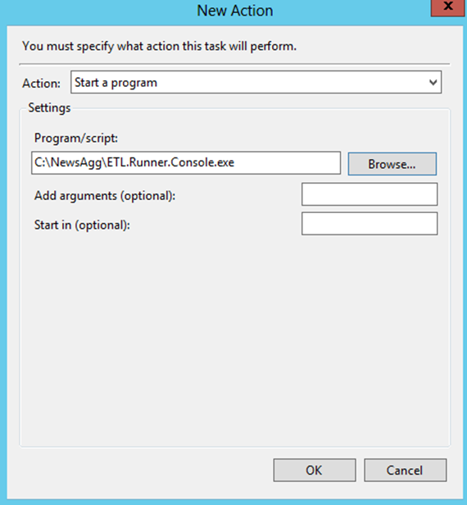
Set the file you want to run and click ok.

Slide 7
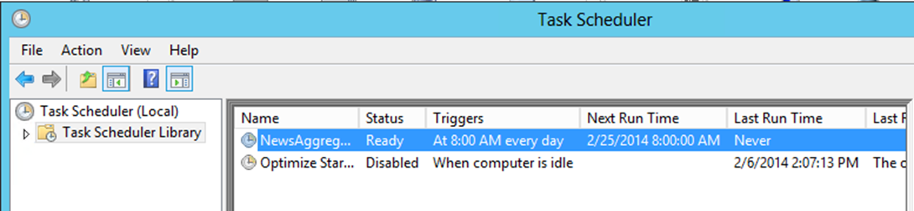
The scheduled task for the News Aggregator

Slide 8
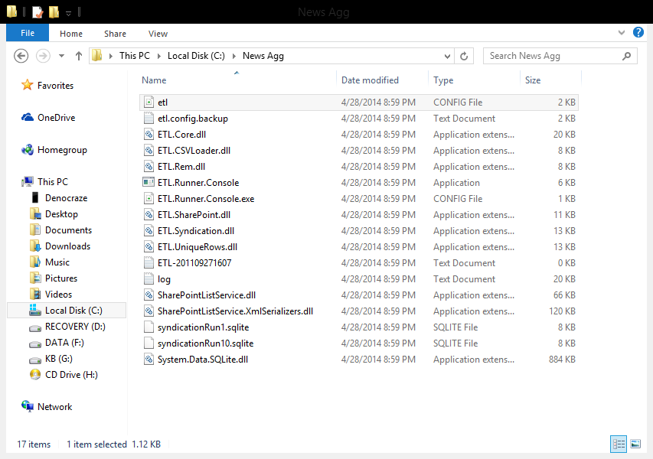
Navigate to the “NewsAgg” folder you copied and open the top file called “etl”

Slide 9
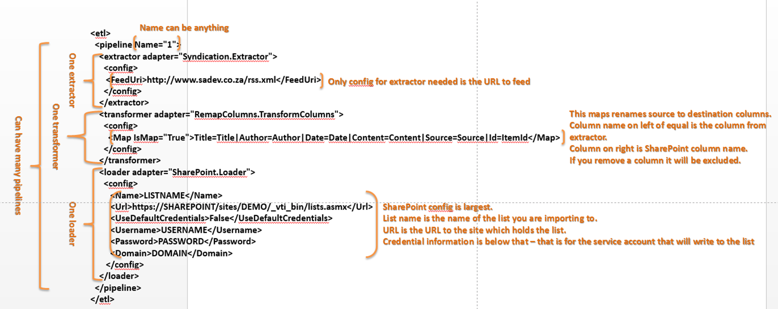
Detailed description of the Config file. The extractor and the loader are worthy of note when modifying.

Slide 10
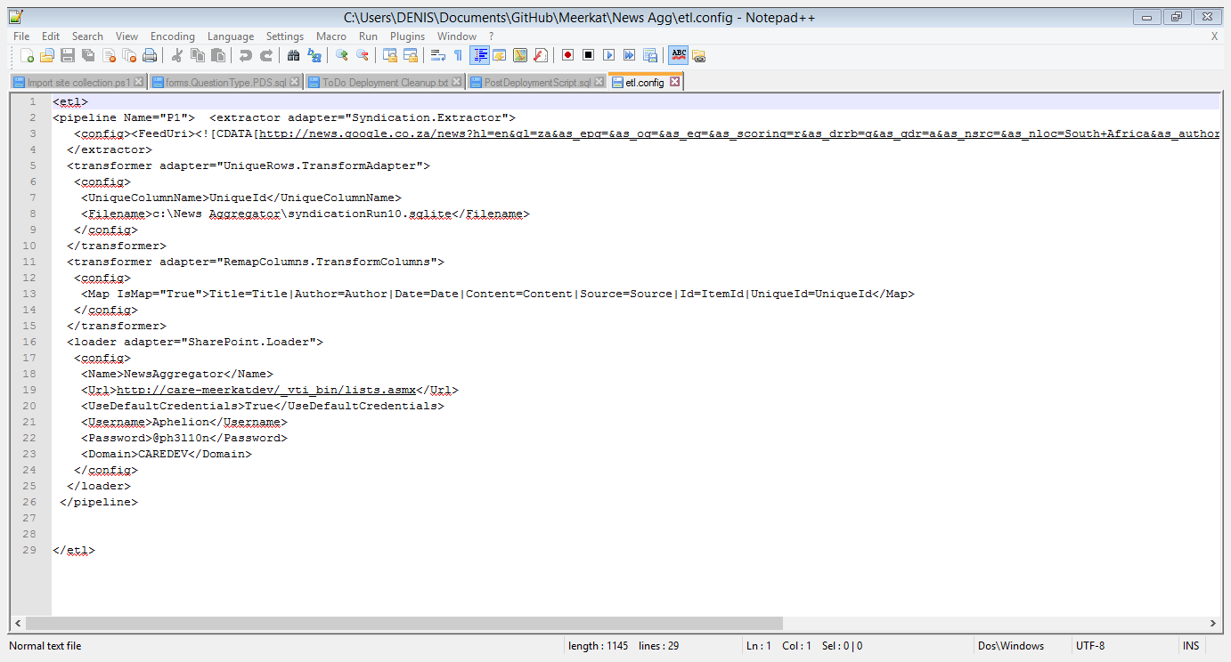
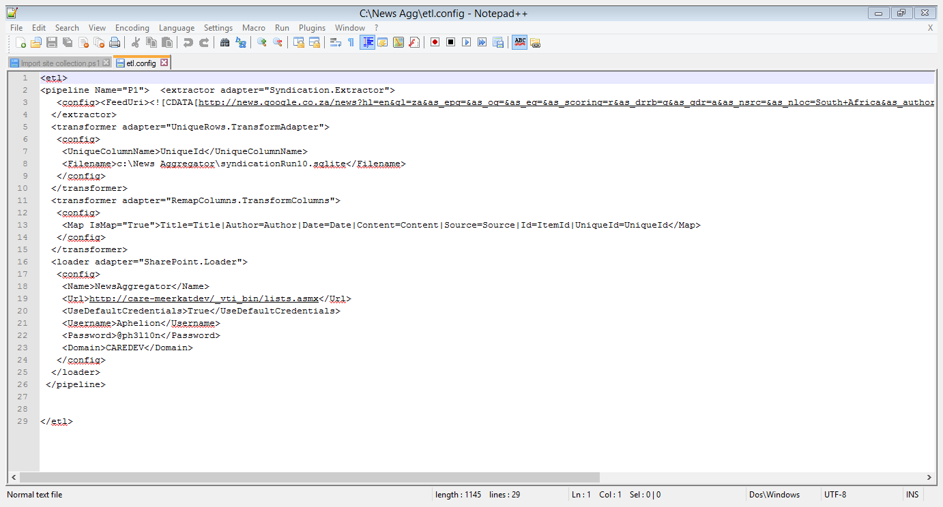
A modified version of the Config file. Take note that the credentials have been modified.

